Slide 1


Drops of LTSpice
How to use the
Arbitrary Voltage Source

Slide 2
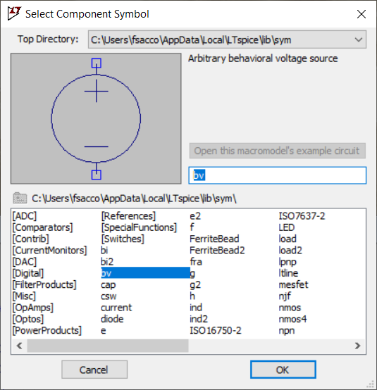
LTSpice contains a very interesting component...
The
Arbitrary Behavioral Voltage Source

Slide 3
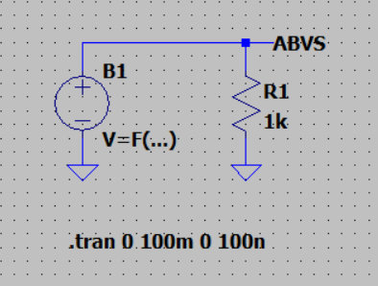
It looks like a standard voltage source.
But notice the
V=F(...)

Slide 4
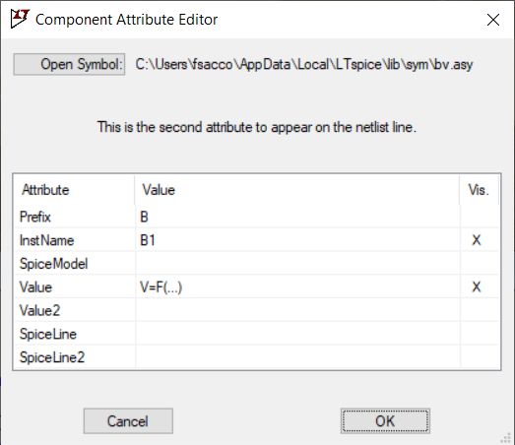
By editing the component, it is possible to add a mathematical function
This function will define the voltage behavior.

Slide 5
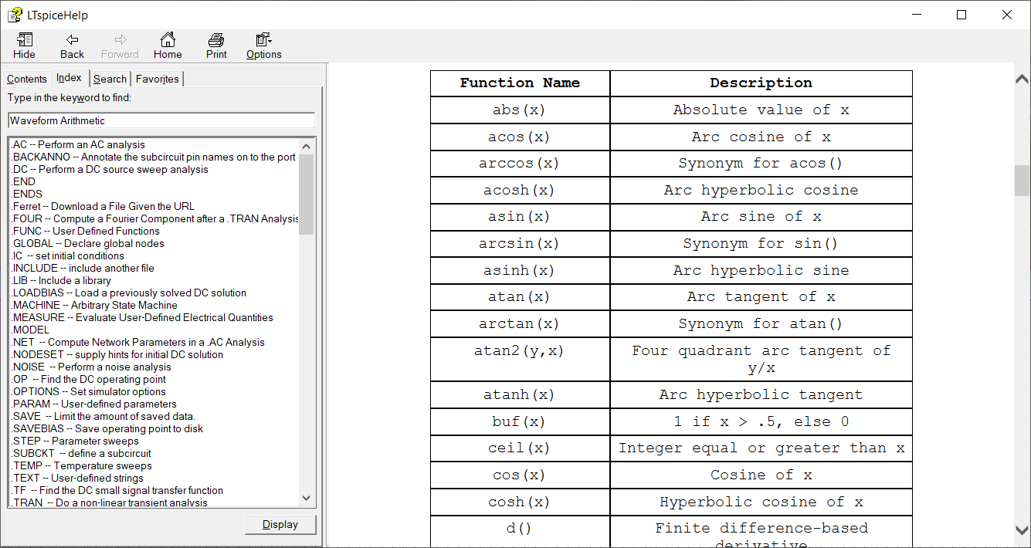
In the software's help window you can get details of all the functions that can be used, searching for Waveform Arithmetic
But I will demonstrate some of them.

Slide 6
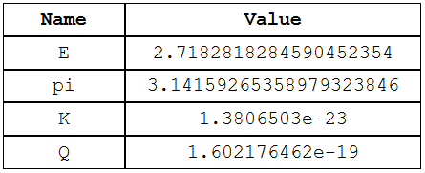
There are some constants that you can use. The pi, for example.
time is another important keyword!

Slide 7
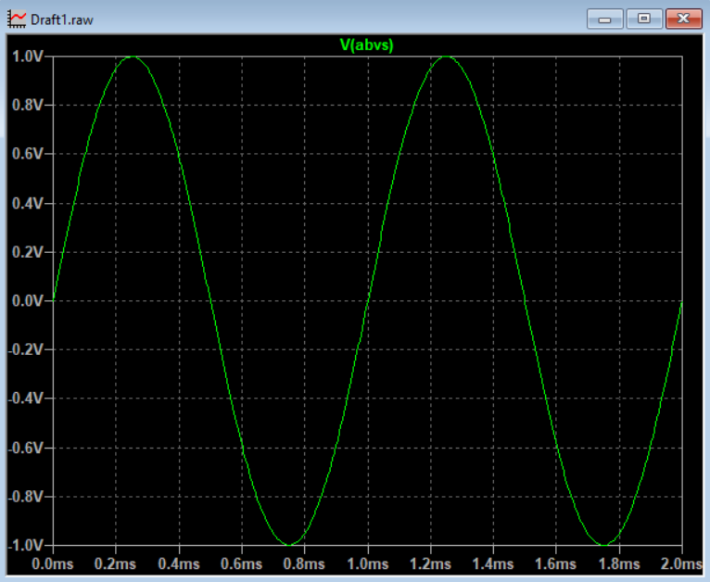
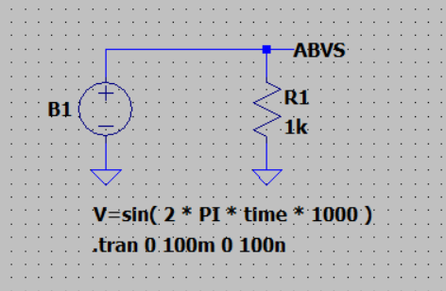
To have a 1kHz sinusoidal signal, the function is
V=sin( 2 * PI * time * 1000 )

Slide 8
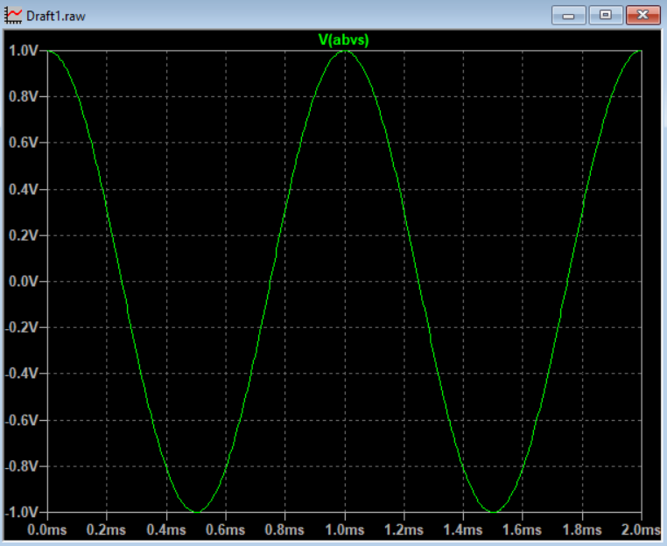
And to have a cosine…
V=cos( 2 * PI * time * 1000 )

Slide 9
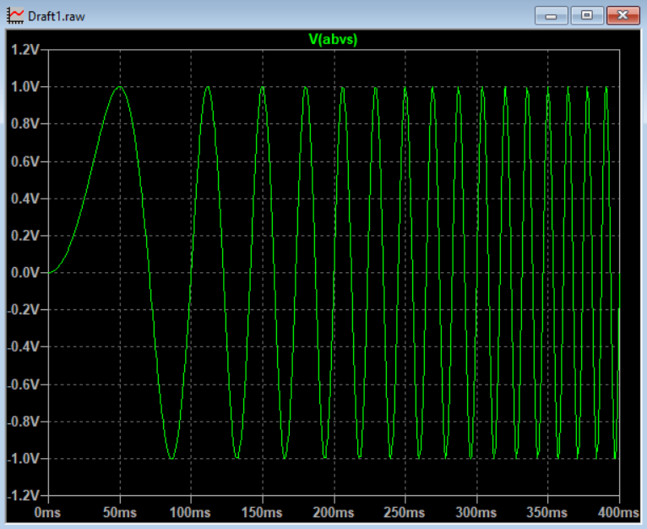
LTSpice allows advanced functions
V=sin( 2 * PI * 100 * time ** 2 )

Slide 10
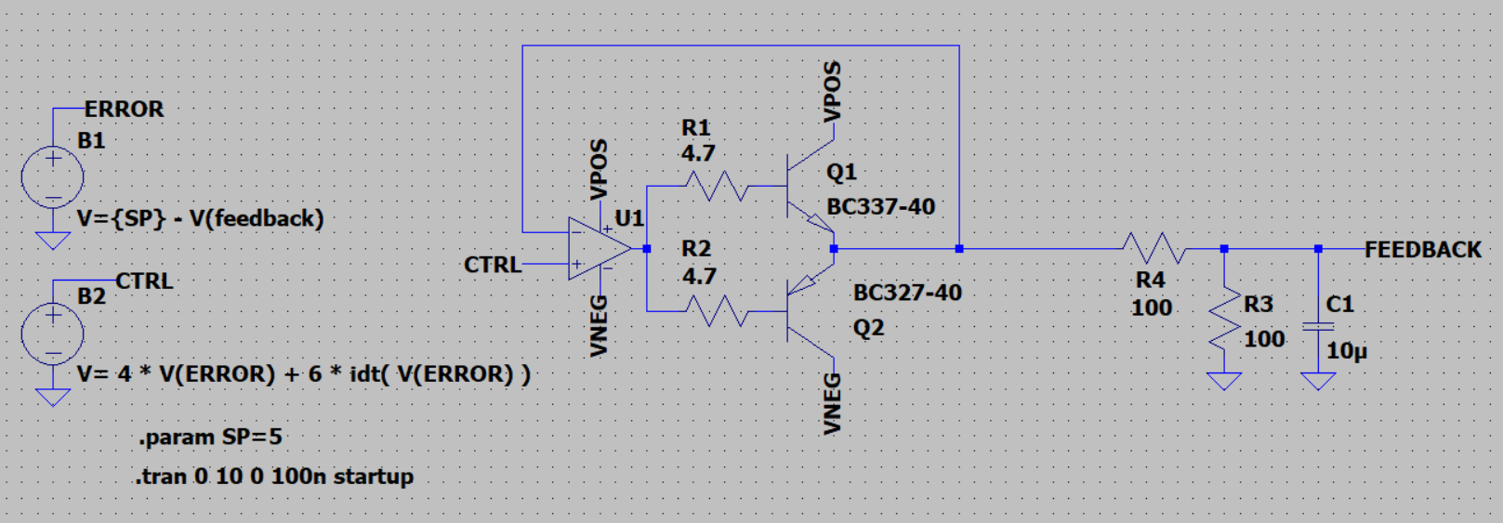
Very advanced functions.
Here we use an arbitrary source to calculate the error, and the result is fed to another to perform a PI.
Francesco Sacco
linkedin.com/in/saccofrancesco

